Slide 1

HTML
Hypertext Markup Language

Slide 2
What is html ?
1,HTML is the Skeleton of a website
2, HTML stands for HyperText Markup Language
3, HTML uses tags to describe content
4, HTML is the foundation of all websites

Slide 3
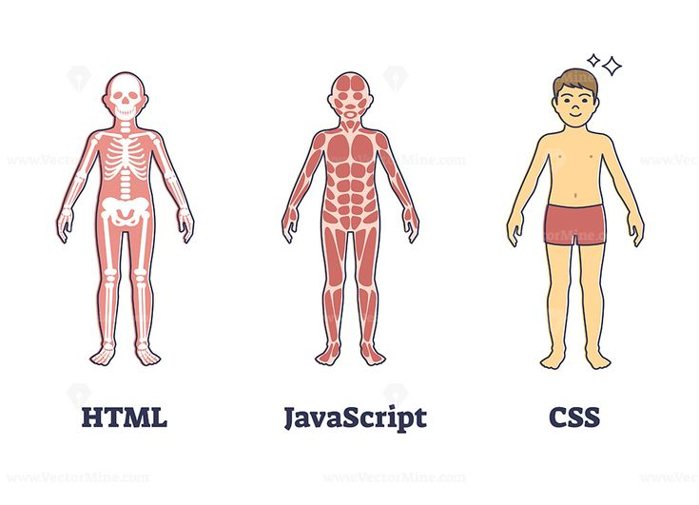
What is html ?

Slide 4
HTML Element & Tag
An HTML tag is a label or marker that tells the browser how to display content on a webpage.

Slide 5
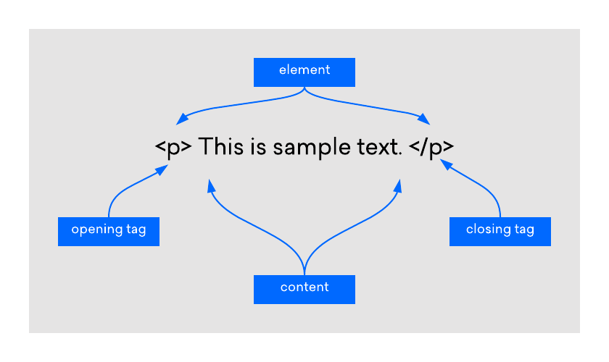
HTML Element & Tag

Slide 6
HTML Attribute
Attribute gives extra information about an HTML tag.
Written inside the opening tag
Customize or control the behavior of the element.

Slide 7
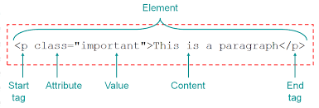
HTML Attribute

Slide 8
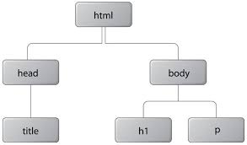
HTML Structure

Slide 9
HTML Headings
"Headings are titles or subtitles that organize content on a webpage. They are written using <h1> to <h6> tags.

Slide 10
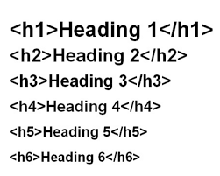
HTML Headings

Slide 11
HTML Paragraphs
The HTML <p>tag is a fundamental element used for creating paragraphs in web development

Slide 12
HTML Line Break
creates a line break in text, effectively starting a new line without starting a new paragraph. <br>

Slide 13
HTML Italic
The <i> tag is a general-purpose tag used to render text in italics without adding any extra meaning. This is useful for stylistic purposes like foreign phrases, taxonomic names, or text in a different voice.

Slide 14
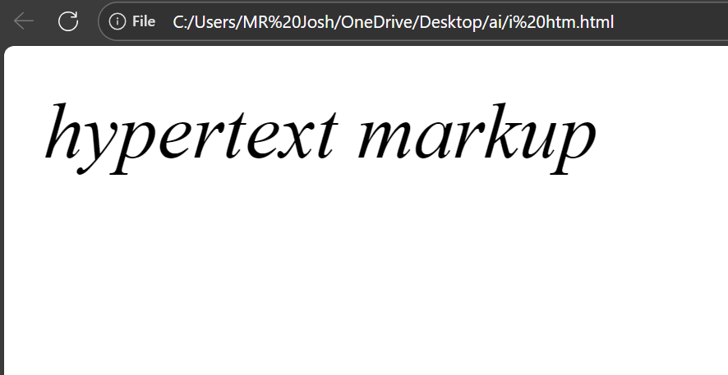
HTML Italic

Slide 15
HTML Bold
Bold text in HTML is created using <b> tags to make the text thicker and stand out.

Slide 16
HTML Underline
used to underline text within an HTML document. By placing text inside the <u>opening and closing tags

Slide 17
HTML <sub> &<sup>
<sub> is used to display subscript text, which appears slightly below the normal line.
It is commonly used in chemical formulas like H<sub>2</sub>O.
<sup> is used to display superscript text, which appears slightly above the normal line.
It is used in math expressions like x<sup>2</sup> or ordinal numbers like 1<sup>st</sup>.

Slide 18
HTML Links
Used to create clickable text that opens another webpage, section, file, or resource.
By placing text inside the <a>opening and closing tags, and adding an href attribute, the text becomes a hyperlink.

Slide 19
HTML List
Used to display items in a structured way inside a webpage.
By placing items inside the list opening and closing tags, the browser shows them as bulleted or numbered lists.

Slide 20
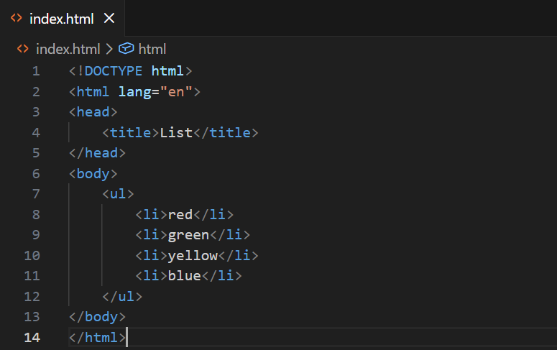
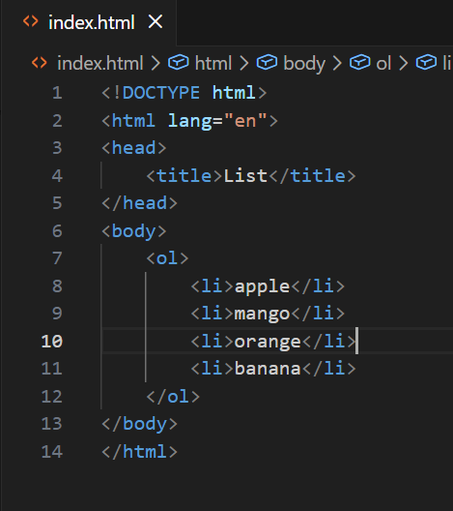
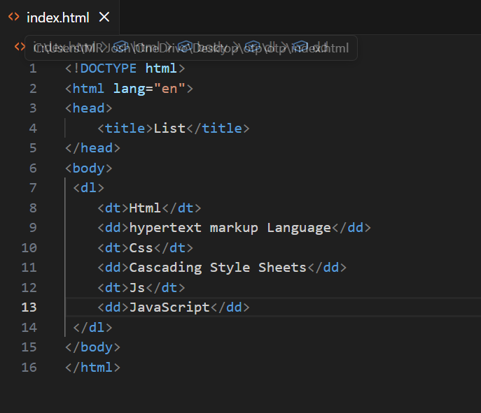
HTML List

Slide 21
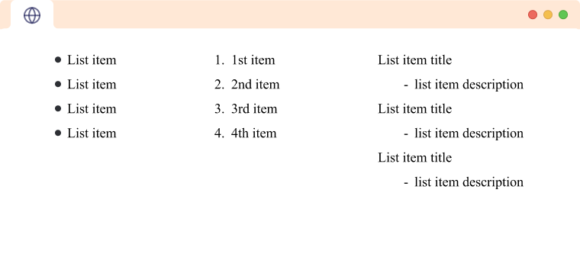
HTML List

Slide 22
HTML Table
Used to display information in rows and columns inside a webpage.
By placing content inside the <table> opening and closing tags, the browser shows data in a structured grid format.

Slide 23
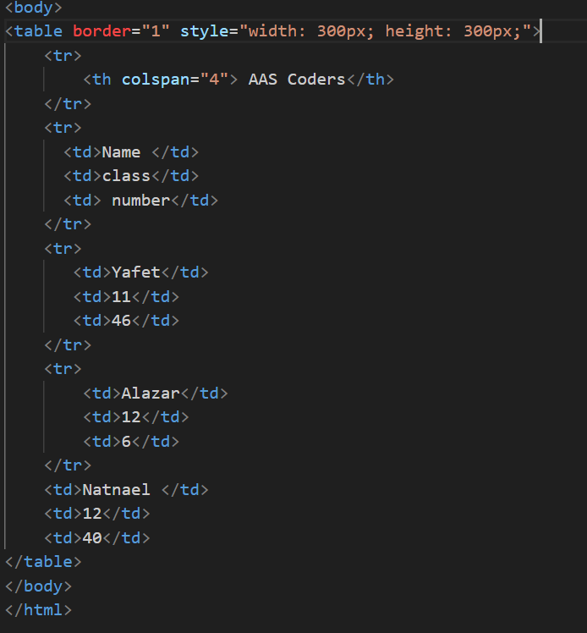
HTML Table

Slide 24
HTML Form
Used to collect user input on a webpage.
By placing fields inside the <form> opening and closing tags, a browser creates an area where users can enter information.

Slide 25
HTML Image
The <img> tag is used to embed images into a webpage.
It is an empty (self-closing) element, meaning it does not have a closing tag.
All the control and information for the image are given through attributes.

